Slide 1
Movie Ticket Booking System
PREPARED BY:- Aman Vyas

Slide 2
Introduction
This project is aimed at developing an movie ticket booking system for customers. This project saves lots of time as booking the movie ticket can be done from anywhere and at any time(24*7). some features provided to the users are new registration, login, see movies by category, timing, customer can book ticket without registration but if he/she registers then he/she will get different types of special offers, e-newsletters, movie updates and lots more through E-mail. The user can also cancel or update their order as well.

Slide 3
Hardware and Software Required
After analyzing existing system to see which of their features ware useful and how they could be improved. The hardware and software requirements are sufficient for installing and running the application. Requirement for this project are:

Slide 4
Database design
The database consists of 3 tables which are as follows:-
Table Name | Description
User_Data | It stores the login details of Admin as-well-as User
Theatre | It consist of the record of all the Theatres (Multiplex and Cineplex both) in a city
Movie | It consist of currently running Movies and shows in a particular theatre in a city

Slide 5
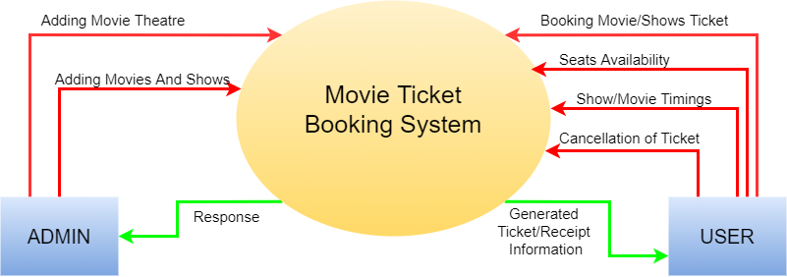
0th level dfd (Data flow diagram)

Slide 6
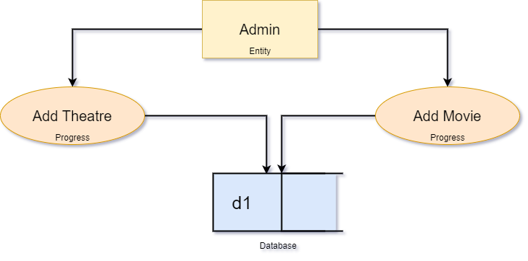
Categorization or 1st level dfd

Slide 7
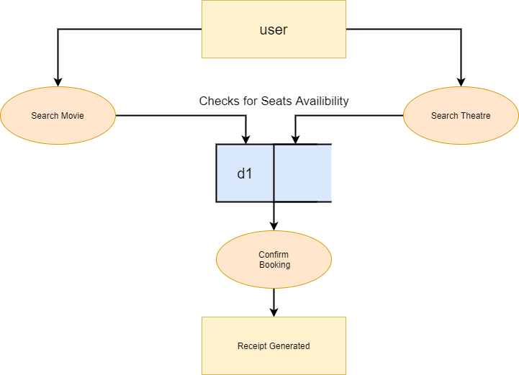
Categorization or 1st level dfd

